Slide 1
Monarchs of England
CFG Kickstarter - Data & SQL Project
Alexandra Boliver-Brown
17th January 2024

Slide 2
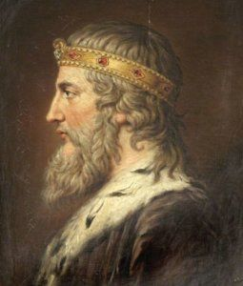
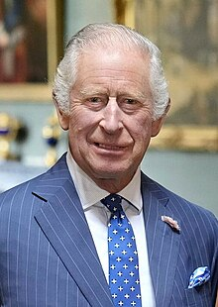
Reasoning
Lots of easily accessible and quite reliable data
Lots of interesting queries with relatively simple data

Slide 3
Assumptions
Data relies on publicly accessible records and are correct to the best of my knowledge.
Not all monarchs had precise date information available
Some early monarchs reigns are uncertain.
If their dates are broad I have used the start of the year in the date columns.
I haven’t included disputed monarchs or monarchs who did not have a coronation.
Death data isn’t complete.
Edward V disappeared from the Tower of London, along with his brother, shortly after his uncle Richard III usurped him.

Slide 4
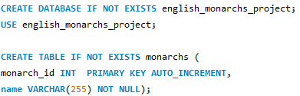
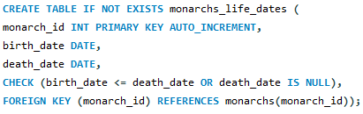
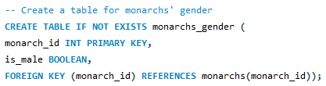
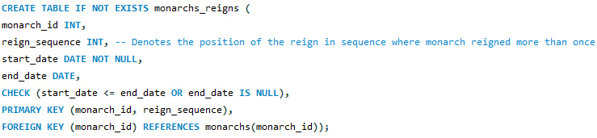

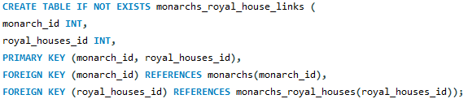
Database Creation (six tables)
monarchs
monarch_id, monarch_name
monarchs_gender
monarch_id, is_male
monarchs_life_dates
monarch_id, birth_date, death_date
monarchs_reigns
monarch_id, reign_sequence, start_date, end_date
monarchs_royal_house
royal_houses_id, royal_houses_name
monarchs_royal_house_link
monarch_id, royal_houses_id
Notes:
(six tables)

Slide 5
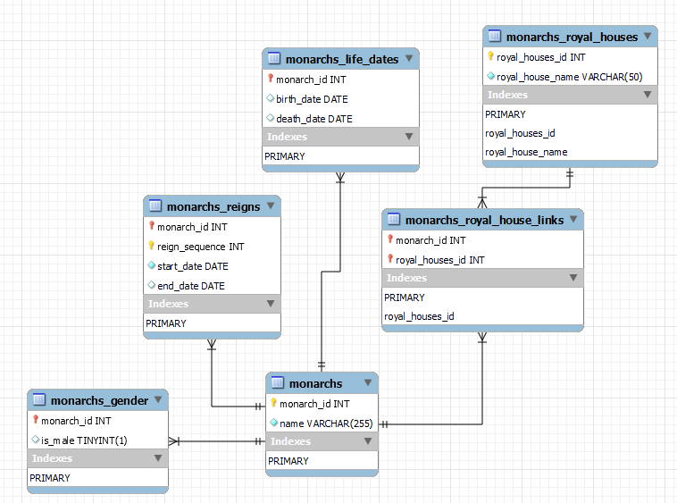
Database Structure
Notes:
Demonstrates how the six tables are linked together.

Slide 6
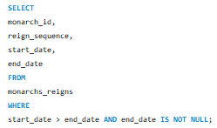
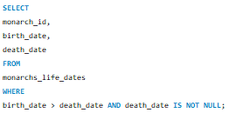
Troubleshooting
Notes:
When I started trying to use my database to run queries I had some strange results .
I wondered if I’d typed some dates incorrectly when entering the data. (… I HAD!)
I used this query to check that all of the dates were logical.
Wrote the CHECK into the tables’ creation to prevent further errors in the future.

Slide 7
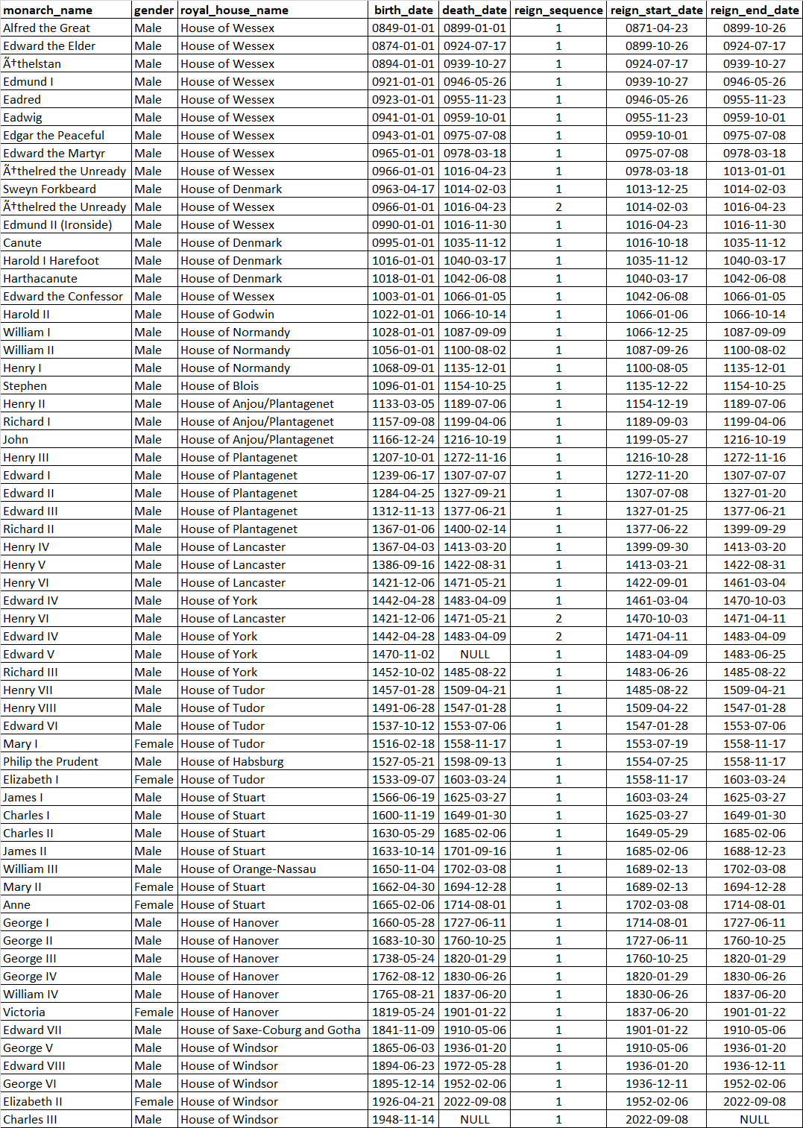
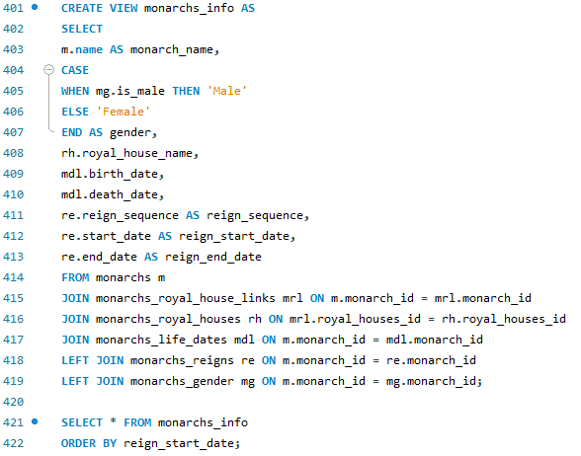
Summary View
Notes:
This shows all of the inputted data from the six tables.
Tables are normalised so used JOIN function to view the data concurrently

Slide 8
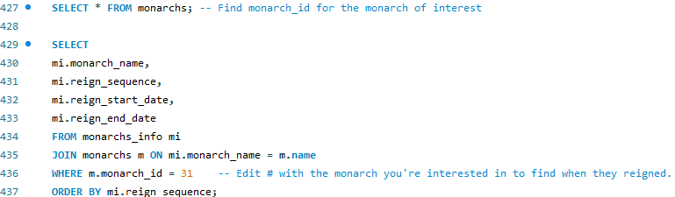

QUERY: What dates did monarchs reign?
Notes:
This is a simple query calling the reign start and end dates for each reign for the monarch of interest

Slide 9
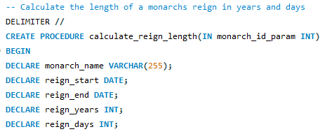
PROCEDURE: How long did monarchs reign for?
I wanted a way to find out how long monarchs reigned for in years and days without having to manually work it out.
I created a procedure that started by creating new variables:

Slide 10
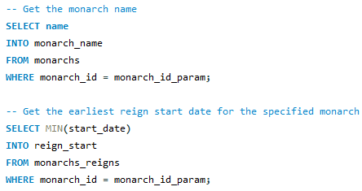
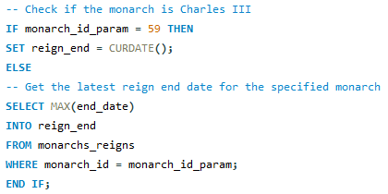
PROCEDURE: How long did monarchs reign for?
Next, I retrieved the relevant information and stored that in the newly created variables.
I opted to use the MIN and MAX functions relating to the dates to account for monarchs who had multiple reigns
I also needed to account for the current monarch. The reign end date is NULL and so I used an IF clause to check if the monarch ID (59) was the called parameter, and if so, set the reign end to the current date.

Slide 11
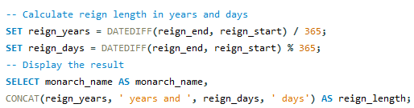


PROCEDURE: How long did monarchs reign for?
I calculated the difference in days between the two dates and divided by 365 to work out the years reigning and then used the % feature to get the remainder from that calculation and export into the newly declared variables.
Lastly, I wrote the output by concatenating the variables.

Slide 12
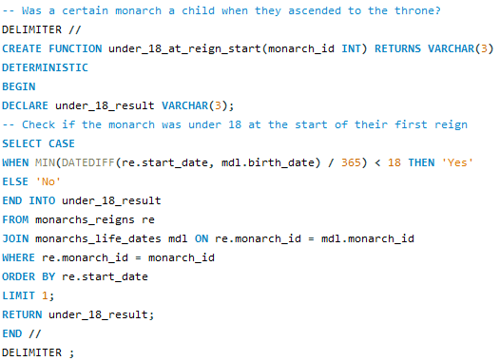


FUNCTION: Was the monarch a child when they ascended?
I created a function that determines whether or not the specified monarch was a child when their reign began.
37 = Edward VI

Slide 13
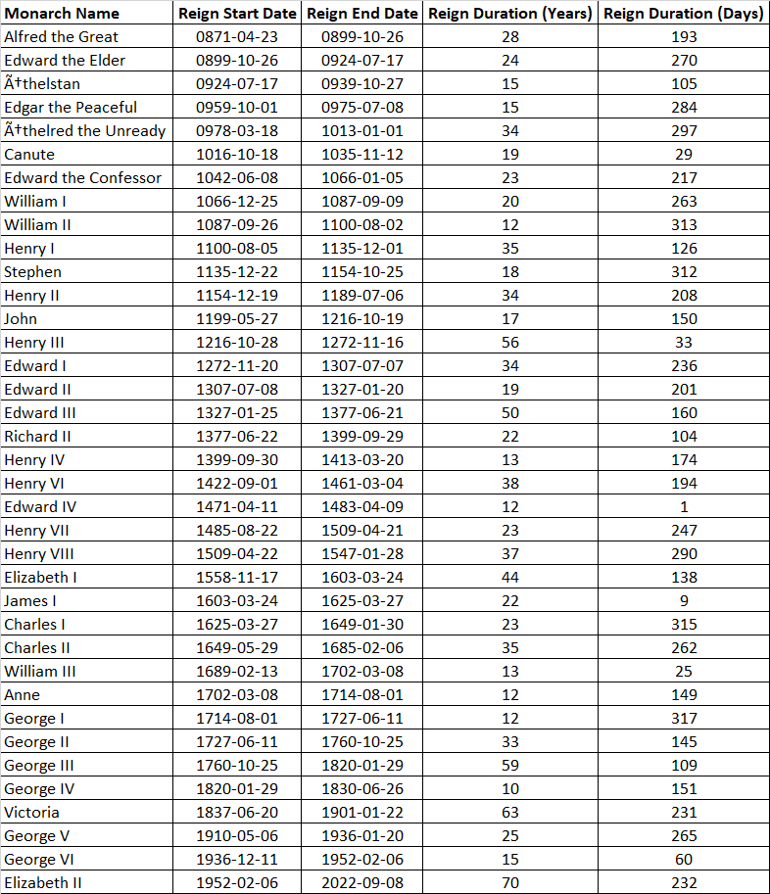
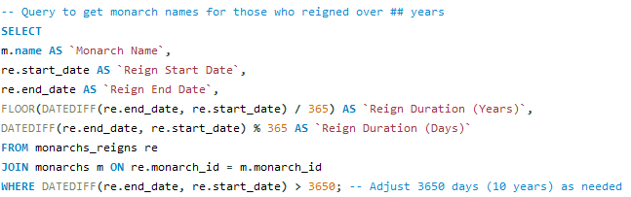
Other queries!
Also easily modified by reversing the > to find monarchs who reigned for less than # days

Slide 14
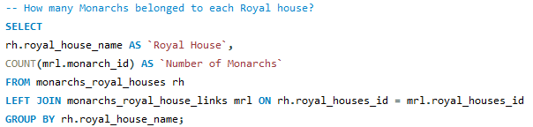
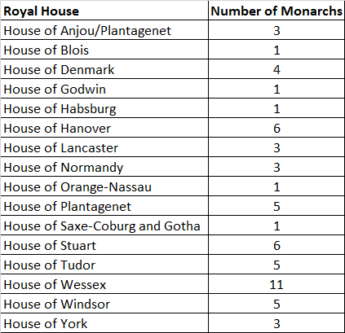


Other queries!

Slide 15
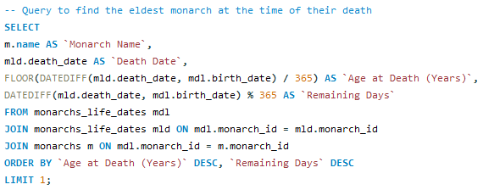

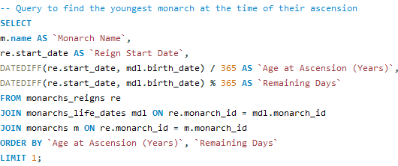

Other queries!

Slide 16
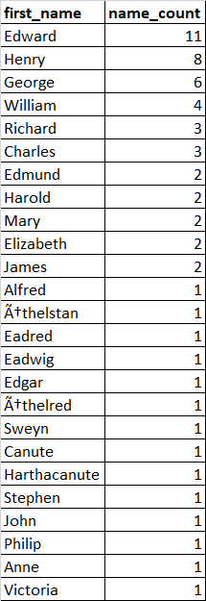
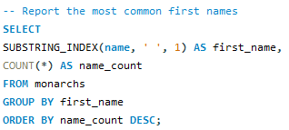
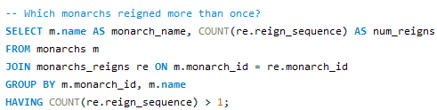

Other queries!

Slide 17
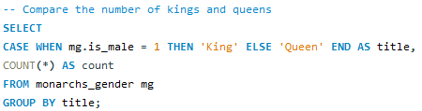

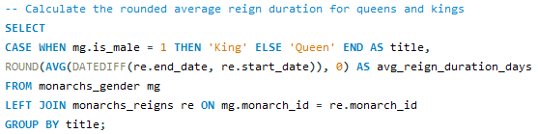

Other queries!

Slide 18
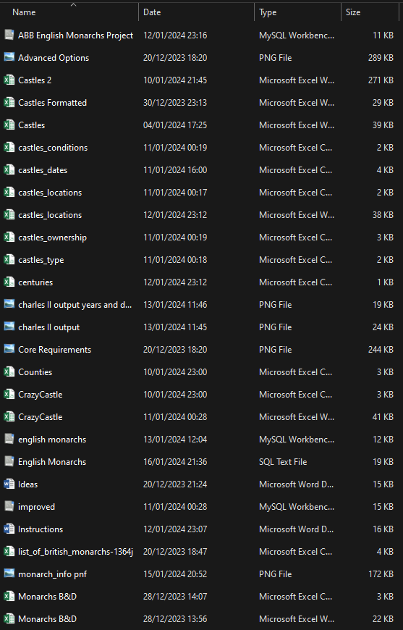
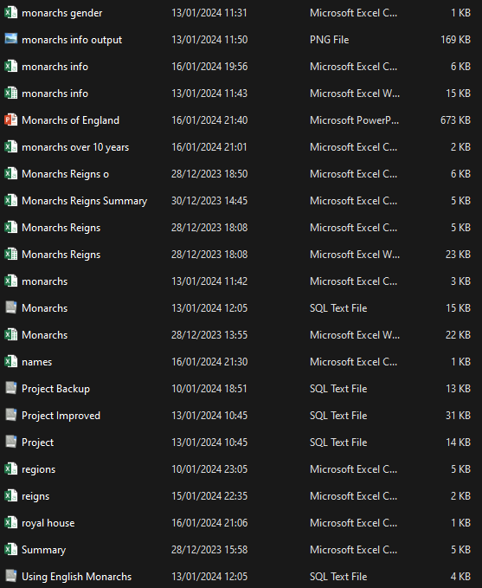
Reflection
Most of the troubleshooting hours were spent on data entry errors.
I could improve this by keeping better track of my spreadsheets with the relevant information that had to be transposed.
I wish I also had a record of my first version of the database. It was nowhere near as complex as the current form.
In the future I would work on clearly labelled versions of the script so I can see previous iterations.
My project folder in its current state

Slide 19
Next Steps!
When I started working with the count and average functions I began to wonder if I could analyse the data statistically in MySQL workbench.
I managed to calculate the mean reign length, standard deviation and count for the kings and queens but didn’t figure out how to perform the t-test.
This is something I managed to perform using R during my degree but not something I have done recently.
I now want to explore interfacing MySQL with other programming languages to deepen my analytical potential.

Slide 20

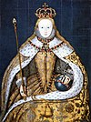

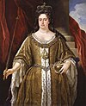

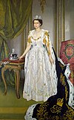
Thank you for your time
Notes:
Thank you Rui and Ese for teaching us. I’ve really enjoyed myself and I’m looking forward to trying to figure out the next problem. As someone who didn’t even study GCSE history I am going to do much better on the history round of the next pub quiz

